Slide 1
Memory System

Slide 2
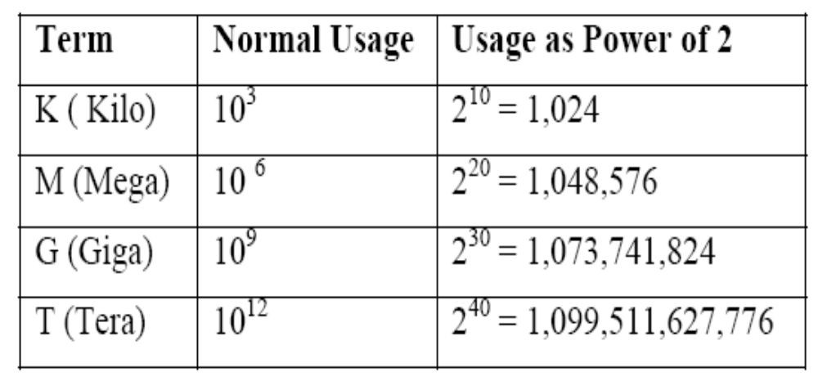
Memory Capacity
Number of bytes that can be stored

Slide 3
Key Characteristics
Location
  CPU
  Internal (main)
  External (secondary)
Capacity
  Word size
  Number of words
Unit of transfer
  Word
  Block
Access methods
  Sequential access
  Direct access
  Random access
  Associative access
Performance
  Access time
  Cycle time
  Transfer rate

Slide 4
Key Characteristics contd.,
Physical Type
  Semiconductor
  Magnetic surface
  Optical
Physical Characteristics
  Volatile / Non-Volatile
  Erasable / Non-erasable
Organization

Slide 5
Location
Three locations of memories
  CPU
    Registers – used by CPU as its local memory
  Internal memory
    Main memory
    Cache memory
  External memory
    Peripheral devices – disk, tape – accessible to CPU via I/O controllers

Slide 6
Capacity
Internal memory capacity is expressed in terms of bytes or words.
External memory capacity is expressed in terms of bytes (depends on words in memory)
Total memory = number of words × word length
Number of words = 2^{address bus width}
Word length = Data bus width

Slide 7
Unit of transfer
Internal memory – number of data lines into and out of the main memory module
External memory – blocks – longer units than a word

Slide 8
Access Methods
Four types
  Sequential Access
    Shared read/write head is used, and this must be moved its current location to the desired location, passing and rejecting each intermediate record.
    So, the time to access an arbitrary record is highly adjustable
    Accesses the memory in predetermined sequence
    Slower than random access memory
    Ex: Magnetic Tapes
Motion
Read – write head

Slide 9
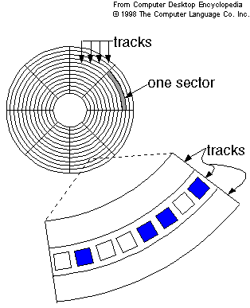
Access Methods contd.,
Direct access
  Also referred as semi random access memory
  Shared read/write head is involved.
  Access time is variable
  The track is accessed randomly but access within each track is serial
  Ex: Magnetic Disk

Slide 10
Access methods contd.,
Random Access
  Each addressable location in memory has unique, physically wired – in addressing mechanism
  Time to access a location is independent of the sequences of prior access and is constant
  Main memory systems are a random access
  Storage locations can be accessed in any order
  Semi conductor memories
Read write head selector
Read write heads
Storage locations

Slide 11
Access Methods contd.,
Associate Access
  Word is retrieved based on portion of its contents rather than its address
  Has own addressing mechanism
  Retrieval time is constant
  Access time is independent of location or prior access patterns
  Cache memories

Slide 12
Performance
Access time
  The time required to read / write the data from / into desired record
  Depends on the amount of data to be read / write
  Random access memory
    Time from the instant that an address is presented to the memory to the instant that data have been stored or made available for use.
  Non-random access memory
    Time it takes to position read-write head at the desired track (seek time) + transfer time + to position read-write head at the desired sector (rotational latency)
Memory Cycle time
  Access time + time required before a second access can commence
  Access + latency

Slide 13
Performance contd.,
Transfer rate
  Rate at which the data can be transferred into or out of a memory unit
  Random access memory
    1/cycle time
  Non-Random access memory
    T_{n} = T_{a} + (N/R), where
      T_{n} – average time to read or write N bits
      T_{a} – average access time
      N – Number of bits
      R – Transfer rate, in bits per second (BPS)

Slide 14
Physical characteristics
Volatile memory
  Information decays naturally or lost when electrical power is switched off
Non-volatile memory
  Once recorded is retained until deliberately changed
  No electrical power is needed to retain information
  Magnetic surface memories
Semiconductor memories may be either volatile or non-volatile
Non-erasable memory
  Cannot be altered, except by destroying the storage unit (ROM)
  A practical non-erasable memory must also be non-volatile

Slide 15
Organization
Physical arrangement of bits to form words
2 types
  1 dimensional
  2 dimensional

Slide 16
Byte Storage Methods
Big-Endian
  Assigns MSB to least address and LSB to highest address
  Ex: 0 × DEADBEEF
Memory Location | Value
Base Address + 0 | DE
Base Address + 1 | AD
Base Address + 2 | BE
Base Address + 3 | EF

Slide 17
Byte Storage Methods contd.,
Little Endian
  Assigns MSB to highest address and LSB to least address
  Ex: 0 × DEADBEEF
Memory Location | Value
Base Address + 0 | EF
Base Address + 1 | BE
Base Address + 2 | AD
Base Address + 3 | DE

Slide 18
MEMORY HIERARCHY
Memory Hierarchy
Memory Hierarchy is to obtain the highest possible
access speed while minimizing the total cost of the memory system
Auxiliary memory
Magnetic
tapes
I/O
Main
processor
memory
Magnetic
disks
CPU
Cache
memory
Register
Cache
Main Memory
Magnetic Disk
Magnetic Tape

Slide 19
Cont..
I/O processor manages data transfers between auxiliary memory and main memory.
The cache organization is concerned with the transfer of information between main memory and CPU.

Slide 20
Cont..
CPU REGISTER
Temporary storage of inst & data.
Usually form as general purpose register file for storage data as it is processed.
Each register in the register file can be individually addressed.
MAIN MEMORY
Program and data that are in active use.
Storage locations in the main memory are directly addressed by CPU.
Access time is more than CPU register and the capacity of main memory is large and it is physically separable from CPU.

Slide 21
SECONDARY MEMORY
Large in capacity but slower than main memory.
Stores programs, data files are not required by the CPU.
Access time is large when compared with main memory.
CACHE
Positioned b/w CPU register and main memory
Several levels of cache memory is also available.
Storage capacity is less but its access time is less than main memory.
The goal of every memory system is to provide adequate storage capacity with an acceptable level of performance and cost.

Slide 22
Characteristics
Performance & cost.
Latency
Access modes
Memory retention(preservation)
Access time-cycle time
Data transfer rate or bandwidth
Reliability
Cost of memory per bit is given as
C
c =
S
C=cost of the computer memory system
S= 8 bits of storage capacity

Slide 23
performance
It is determined by the rate at which information can be from or written into the memory.
Basic performance measure is the average time to read a fixed amount of information for instance, one word from the memory. This parameter is called read access time or simply the access time.
Low cost & short access time are desirable memory characteristics , but they tend to be incompatible.
Latency:
The time taken to transfer the data from and to the memory.

Slide 24
Access mode
The order or sequence in which information can be access.
Random access memory
if storage locations can be accessed in any order and access time is independent of the location being accessed, the memory is known as random access memory semiconductor memories are generally this type.
Serial access memory
Memory whose storage locations can be accessed only in a certain predetermined sequence are called serial-access memory [magnetic disk , tapes & optical memories]

Slide 25
Cont..,
Access time: Time between the receipt of a read request signal by a memory and the delivery of the requested information to its o/p terminal.
Cycle time: Minimum time that must pass b/w the start of two consecutive access operations.
Data transfer rate/bandwidth:
Maximum amount of information that can be transferred to or from the memory per unit time is known as bandwidth and measured in bits or words per second
Reliability:
Measured by mean time before failure.
Memories with no moving parts—high reliability
Memories with high storage densities or data transfer rates—less reliability.
Error detecting and error-correcting codes can increase the reliability of any memory

Slide 26
Data compression
Compression is a process of reducing the size of file inorder to save space when storing it to save time when transmitting it and to remove the redundancy in the content.
Generic file compression
Files=GZIP(GNU zip)
BZIP
BOA

